Slide 1

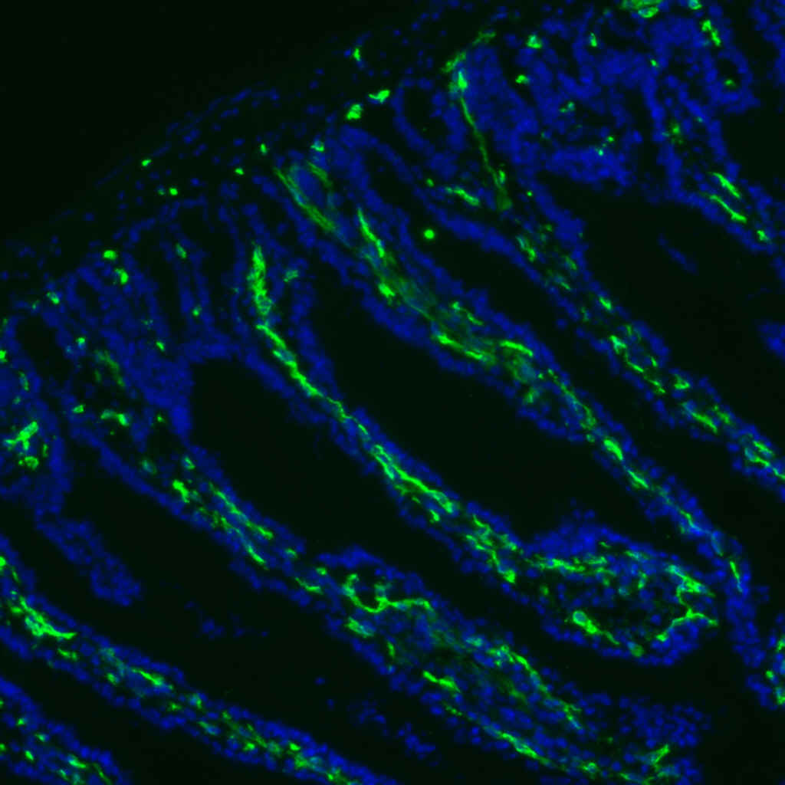
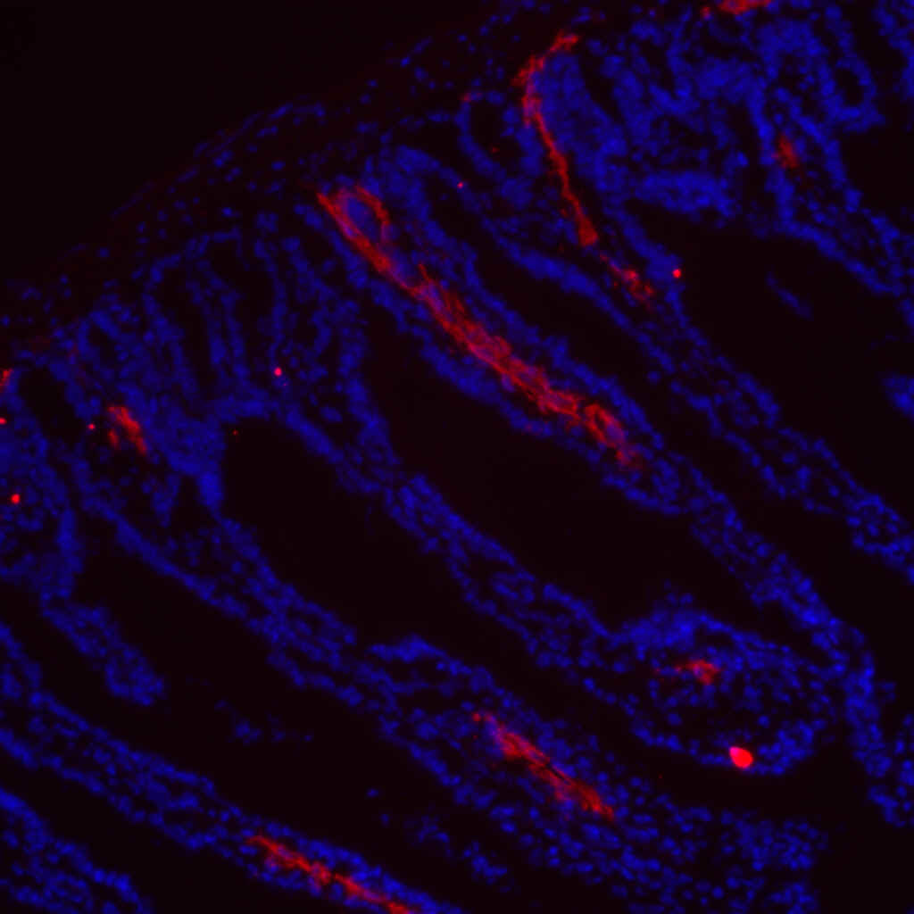
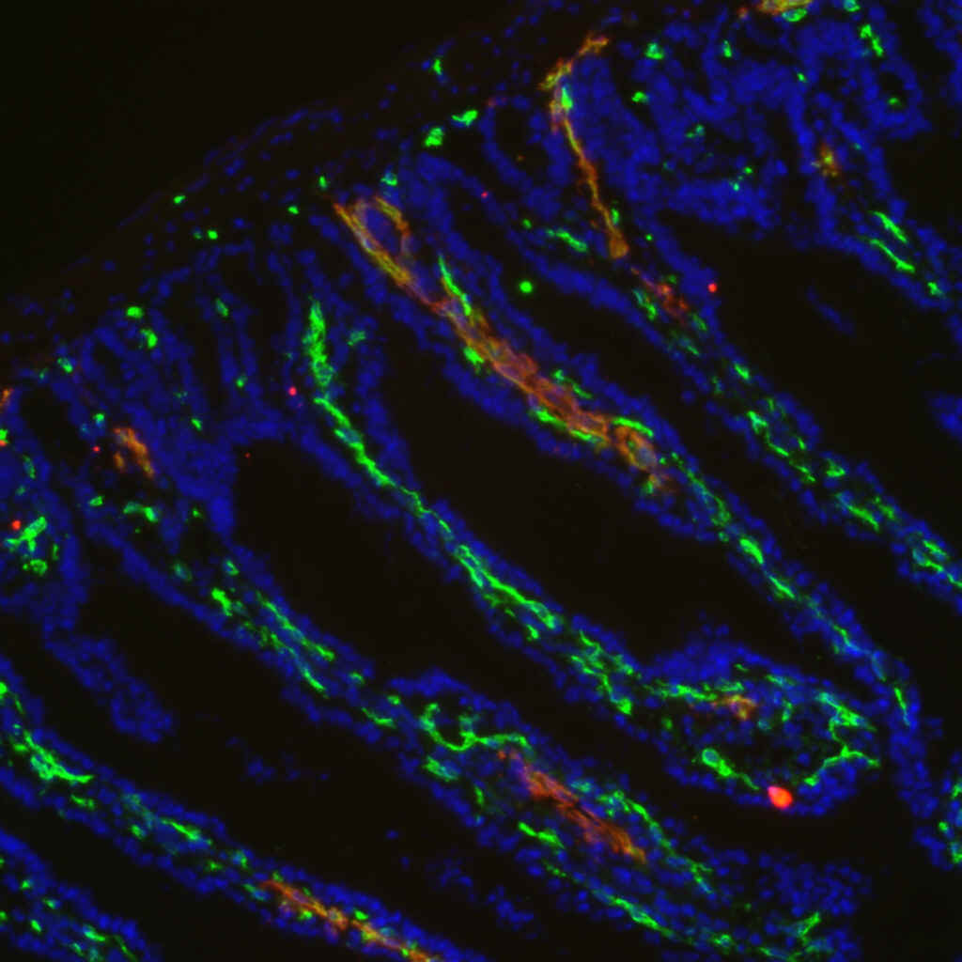
ReliaTech GmbH
Rabbit anti-mouse LYVE-1
(Cat #103-PA50S/-PA50)
Mouse colon tissue:
CD31
LYVE-1
CD31 / LYVE-1
The experiments were perfomed by Dr. Ulrike Fiedler and Stefanie Koidel, Dept. of Vascular Biology and Angiogenesis Research
Tumor Biology Center, Breisacher Str. 117, D-79106 Freiburg, Germany
http://www.reliatech.de / orders@reliatech.de

